Slide 1
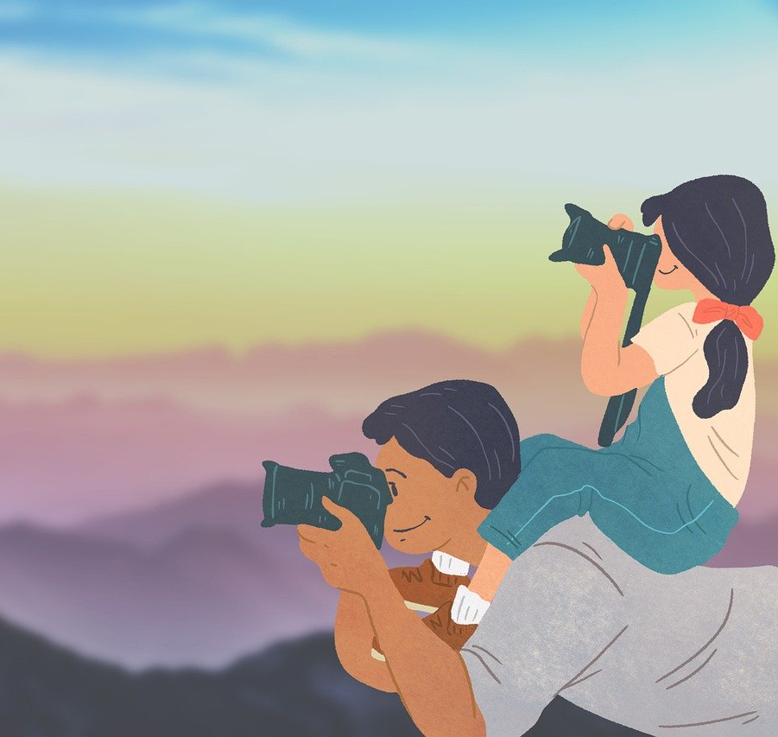

Time with my dad
2024113285 강주영

Slide 2
Contents
A Happy Childhood Memory
Memories with My Dad
Activities I Enjoy with My Dad Now
Do you want to Go Back to Childhood?
What Does Nostalgia Mean to Me?

Slide 3
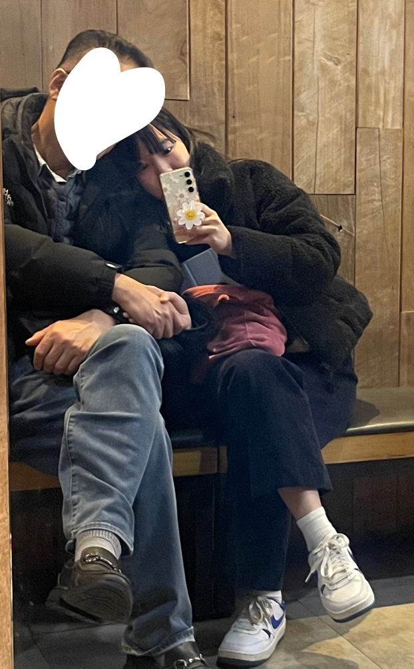
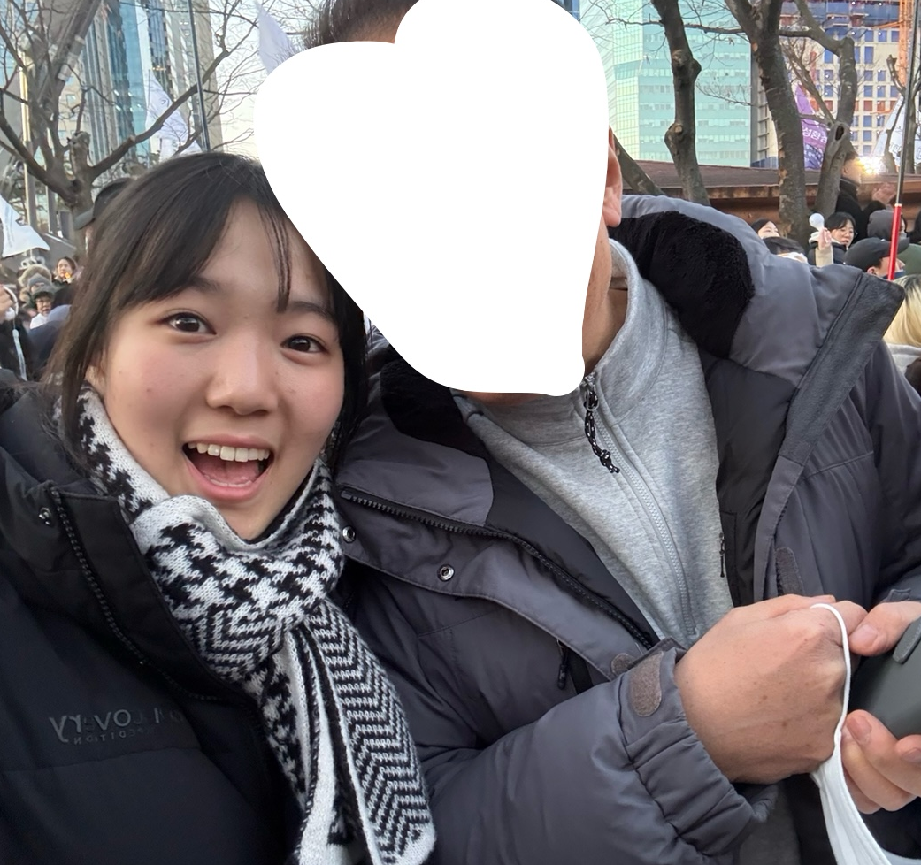
Q : What fun experiences did you have as a child?
A : Times with Dad

Slide 4



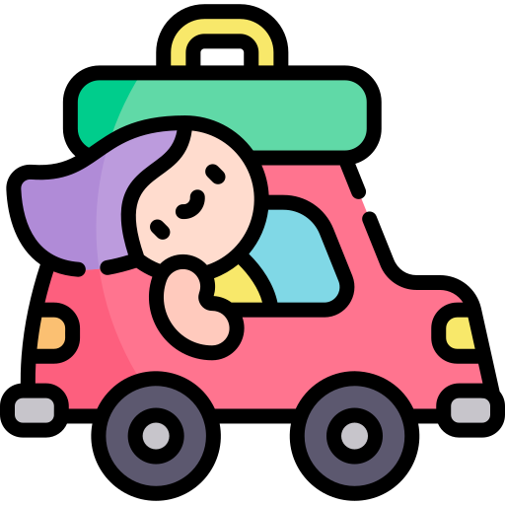
Memories with my dad
when we were young
Badminton
Hiking
Talking
Travel

Slide 5
If you were to choose the most memorable one?
- Pick up acorns while hiking
- Eating at the top of my home-made lunch box
- Let's try echoing
- Let's take a nap in the mountains
Hiking

Slide 6
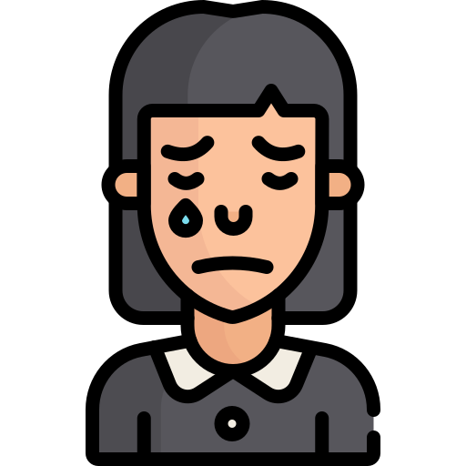

I’m sad that my time
with my dad has been reduced
Don’t be sad and act

Slide 7




What I’ve been doing with my dad lately
Eating a meal
Playing tennis
Singing

Slide 8
Will you go back to your childhood?
YES !!

Slide 9
Lastly, Nostalgia is to me
Something precious that I really want to remember.
Being a memory rather than an experience.
What I want to go back and feel.
If there's anything that reminds me of this memory,
I think I'll definitely buy it.
People know that they can't go back.
Therefore, I want to leave the situation as an irreversible memory,
if there is a perfume (nostalgia) to remember, people will also buy it.

Slide 10
Thank you for my listening
Icons by : https://www.flaticon.com/kr/

